Slide 1
Life of PY

Slide 2
for a in range(0,10):
print(‘true’)
if(a==5):
print(“in middle”)
print(‘false’)

Slide 3
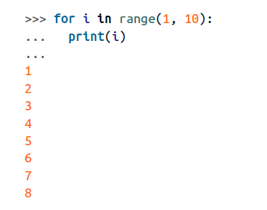
Using the Python Console
>>>for i in range(1,10):
… print(i)
… print(‘b’)
…

Slide 4
Running Python Programs from the Terminal
$ sudo python myprogram.py

Slide 5
Variables
???
Int
Char
Float
Long int
Signed , unsigned………aww I cant remember all of these!!!!

Slide 6
What if???
You want to give a value a name.
Assign a value to a name using =

Slide 7
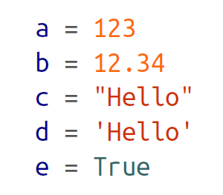
☺ Better way

Slide 8
Displaying Output
Printf() as in C language for example
Syntax???

Slide 9
Python style of console output
>>> x = 10
>>> print(x)
10
>>>

Slide 10
Read console input
I just know scanf(xxxxxxxxx)
But do I remember syntax???

Slide 11
Python Reading User Input
>>> x = raw_input("Enter Value:")
Enter Value:’23’
>>> print(x)
23
>>>
sudo leafpad name.py

Slide 12
Arithmetic
In C……
Step1: define some variable within its data type
Referring to particular variable…….
Errors…….

Slide 13
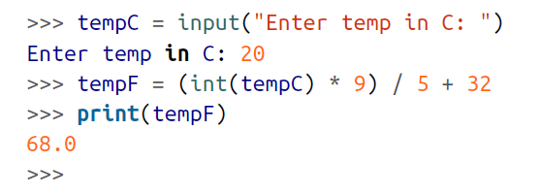
Arithmetic In PY
>>> 2 ** 8
256

Slide 14
Strings
In C….?
Memory of a string
Assigning a string variable
Reading string
String operations
----→big story…!

Slide 15

String operations in PY

Slide 16
>>> s = "name\tplace\npantech\tCoimbatore"
>>> print(s)
name place
pantech Coimbatore
>>>

Slide 17
Concatenating (Joining) Strings
>>> s1 = "abc"
>>> s2 = "def"
>>> s = s1 + s2
>>> print(s)
abcdef
>>>

Slide 18
Is it fine
>>> "abc" + 23
Traceback (most recent call last):
File "<stdin>", line 1, in <module>
TypeError: Can't convert 'int' object to str implicitly

Slide 19
This works fine
>>> "abc" + str(23)
'abc23'
>>>

Slide 20
Converting Numbers to Strings
>>> str(123)
'123'
>>>

Slide 21
Converting Strings to Numbers
>>> int("-123")
-123
>>>
>>> float("00123.45")
123.45
>>>

Slide 22
& some more conversions
>>> int("1011", 2)
11
>>>
>>> int("AFF0", 16)
45040
>>>

Slide 23
Find the Length of a String
>>> len("abcdef")
6
>>>

Slide 24
Find the Position of One String Inside Another
>>> s = "abcdefghi"
>>> s.find("def")
3
>>>

Slide 25
Extracting Part of a String
>>> s = "abcdefghi"
>>> s[x:5]
'bcde'
>>>
>>> s[:5]
'abcde'
>>>
>>> s = "abcdefghi"
>>> s[3:]
'defghi'
>>>

Slide 26
Replacing One String of Characters with Another Inside a String

Slide 27
>>> s = “wait wait wait untill u succeed"
>>> s.replace(“wait", “work")
‘work work work untill u succeed '
>>>

Slide 28
Converting a String to Upper- or Lowercase

Slide 29
For example, to convert aBcDe to uppercase, you would use:
>>> "aBcDe".upper()
'ABCDE'
>>>
To convert it to lowercase, you would use:
>>> "aBcDe".lower()
'abcde'
>>>

Slide 30
Conditions……?

Slide 31
Nothing much changes
; ----→ indentation

Slide 32
Loops & conditions in PY
>>> x = 101
>>> if x > 100:
... print("x is big")
...
x is big

Slide 33
Is It
x = 101
if x > 100:
print("x is big")
else:
print("x is small")
print("This will always print")

Slide 34
This works fine
x = input(‘pass ur number’)
if x > 100:
print("x is big")
elif x < 10:
print("x is small")
else:
print("x is medium")

Slide 35
>>> x = 17
>>> if x >= 10 and x <= 20:
... print('x is in the middle')
...
x is in the middle

Slide 36

>>> for i in range(1, 11):
... print(i)
...
1
2
3
4
5
6
7
8
9
10
>>>

Slide 37
Repeating Instructions Until Some Condition Changes

Slide 38
>>> answer = ''
>>> while answer != 'X':
... answer = input('Enter command:')
...
Enter command:A
Enter command:B
Enter command:X
>>>

Slide 39
GET ME OUT OF HERE
Breaking Out of a Loop

Slide 40
>>> while True:
... answer = input('Enter command:')
... if answer == 'X':
... break
...
Enter command:A
Enter command:B
Enter command:X
>>>

Slide 41
A FUNCTION FOR ALL
HOW WE ARE DEFINING IN C

Slide 42
WRONG WAY BUT Y?
def count_to_10():
for i in range(1, 11):
print(i)
count_to_10()

Slide 43
def count_to_10():
for i in range(1, 11):
print(i)
count_to_10()

Slide 44
Passing Arguments
def count_to_n(n):
for i in range(1, n + 1):
print(i)
count_to_n(5)

Slide 45
def count_to_n(n):
for i in range(1, n + 1):
print(i)
count_to_n(5)

Slide 46
special
Creating a List:
>>> a = [34, ‘Pantech', 12, False, 72.3]
>>>
>>> a = []
>>>

Slide 47
>>> a = [34, ‘pantech', 12, False, 72.3]
>>> a[1]
‘pantech'

Slide 48
>>> a = [34, ‘pantech', 12, False, 72.3]
>>> a.append("new")
>>> a
[34, ‘pantech', 12, False, 72.3, 'new']

Slide 49
Removing elements
>>> a = [34, 'Fred', 12, False, 72.3]
>>> a.pop(0)
34
>>> a = [34, 'Fred', 12, False, 72.3]
>>> a.pop()
72.3
>>> a
[34, 'Fred', 12, False]

Slide 50
